Slide 1
Divide and Conquer (Cont…)

Slide 2
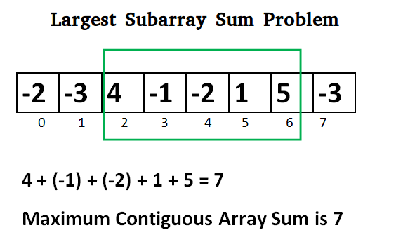
Maximum Subarray Sum

Slide 3
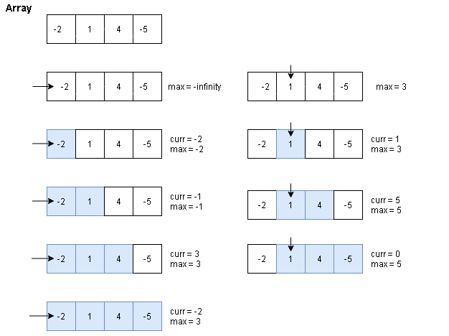
Maximum Subarray Sum

Slide 4
Maximum Subarray Sum
Complexity : O(N²)

Slide 5
Maximum Subarray Sum
Divide the given array in two halves
Return the maximum of following three
Maximum subarray sum in left half (Make a recursive call)
Maximum subarray sum in right half (Make a recursive call)
Maximum subarray sum such that the subarray crosses the midpoint
Time Complexity: T(n) = 2T(n/2) + Θ(n)

Slide 6
Maximum Subarray Sum
Maximum subarray sum such that the subarray crosses the midpoint
return lefpartsum + rightpartsum
for (int i = mid; i >= low; i--) { sum = sum + arr[i]; if (sum > leftpartsum) leftpartsum = sum; } | for (int i = mid+1; i <= high; i++) { sum = sum + arr[i]; if (sum > rightpartsum) rightpartsum = sum; }

Slide 7
Maximum Subarray Sum
Time Complexity: T(n) = 2T(n/2) + Θ(n)

Slide 8
Maximum Subarray Sum (Kadane’s Algorithm)
Local Max: Max possible value including the i^{th} element.
Max(A[i], A[i] + localmax[i-1])
Do we need an array to store localmax?

Slide 9
Maximum Subarray Sum (Kadane’s Algorithm)
Local Max: Max possible value including the i^{th} element.
Max(A[i], A[i] + localmax[i-1])
Do we need an array to store localmax?
Yes, if we don’t keep the track of global max
No, for the previous approach

Slide 10
Maximum Subarray Sum (Kadane’s Algorithm)
Local Max: Max possible value including the i^{th} element.
Max(A[i], A[i] + localmax[i-1])
Global Max: Update every time localmax is calculated
for (i=0; i < n; i++){
localmax = max(A[i], A[i] + localmax);
if(localmax > globalmax)
globalmax = localmax;
}

Slide 11
Maximum Subarray Sum (Kadane’s Algorithm)
for (i=0; i < n; i++){ localmax = max(A[i], A[i] + localmax); if(localmax > globalmax) globalmax = localmax; } | for (i=0; i < n; i++){ localmax = A[i] + localmax; if(localmax > globalmax) globalmax = localmax; if(localmax < 0) localmax = 0; }

